Slide 1
Jackal Robot: Converting Reality to Virtuality through Surrounding Rendering and Object Detection​
By Nishank Singhal​
Email: ns74172n@pace.edu​
GITHUB: https://github.com/nishank20/Capstone_project.git​

Slide 2
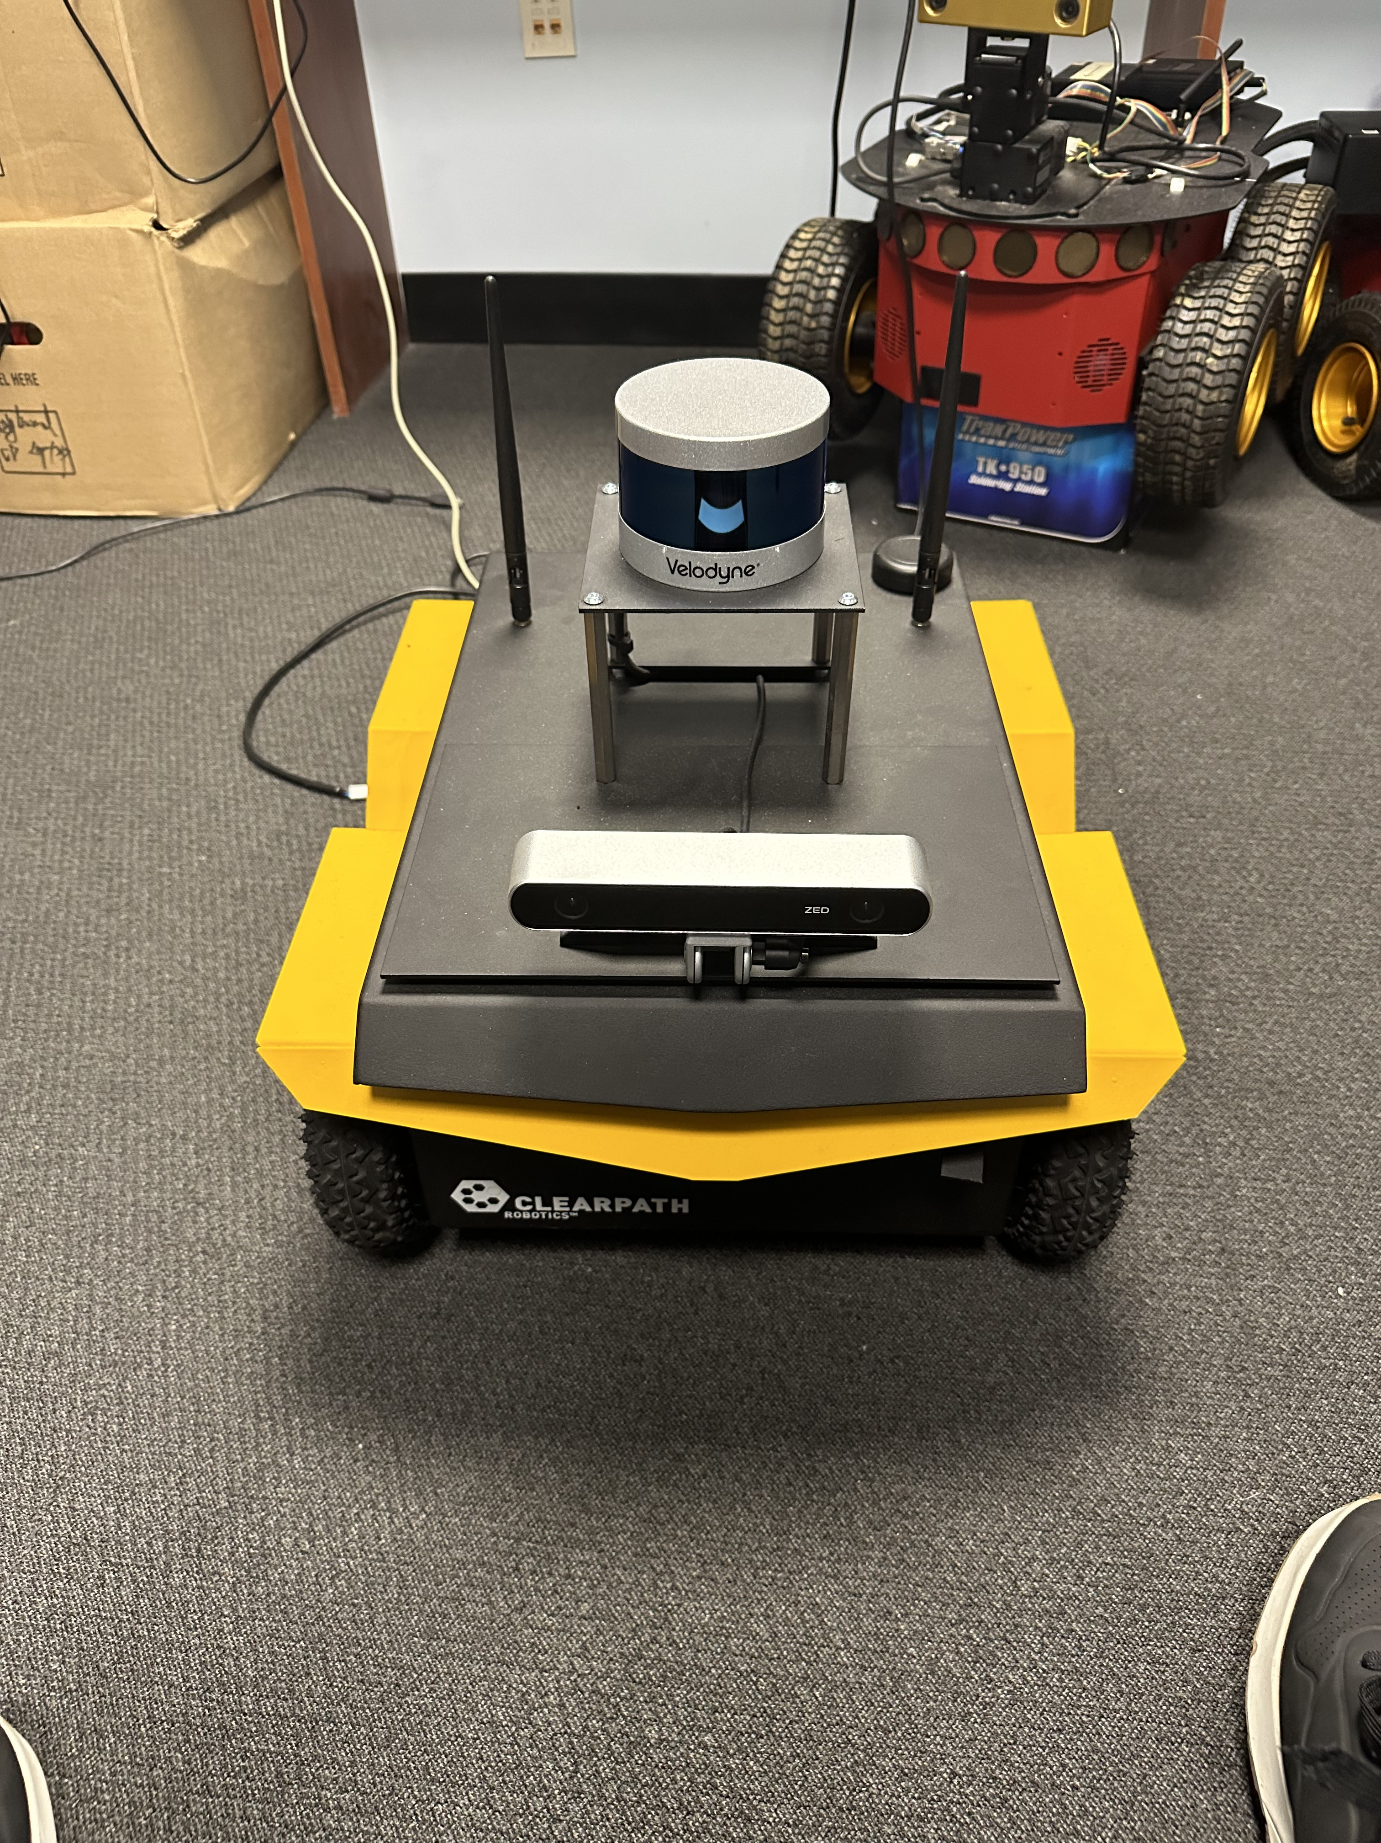
Jackal UNMANNED GROUND VEHICLE Robot
Velodyne VLP-16 Lidar Sensor Puck
I would be using two sensors in Jackal Robot one Velodyne VLP-16 and zed Camera.
Velodyne sensor used to extract Point Cloud laser data
zed Camera used to extract 3 data which is Point Cloud, Depth Image, rgb image.
Zed Camera

Slide 3
Research Question ?
How accurate is object detection from a Jackal Robot in converting real-world surroundings to a virtual world?​
Can Jackal Robot's object detection be improved to enhance the quality of the rendered virtual world?

Slide 4
Motivation ?
Improving the accuracy and efficiency of object detection and surrounding rendering, which can have numerous practical applications in fields such as surveillance, navigation, and automation.
Demonstrating the capabilities of the Jackal Robot for object detection and surrounding rendering and contributing to the development of state-of-the-art robotics systems.
Develop a system that accurately and efficiently converts real-world environments to virtual environments using cutting-edge technology.

Slide 5
Literature Review
"Object Detection using Deep Learning: A Survey" by Shengcai Liao et al. This paper provides a comprehensive survey of object detection techniques using deep learning, including the most popular algorithms and architectures. It could be useful for selecting and implementing the most appropriate algorithms for your project.
"Robot perception of the environment: A survey" by Fabrizio Caccavale et al. This paper provides a survey of techniques and technologies for robot perception of the environment, including sensors, algorithms, and applications. It could be useful for understanding the capabilities and limitations of the Jackal Robot and identifying potential areas for improvement.
"Virtual to Real Reinforcement Learning for Autonomous Driving" by Xinlei Pan, Yurong You, Ziyan Wang, and Cewu Lu presents a novel approach to training autonomous driving agents using reinforcement learning (RL) in a simulated environment, and then transferring the learned policy to the real world. The authors use a generative adversarial network (GAN) to learn a mapping function from the simulated environment to the real environment, enabling the agent to adapt to real-world driving conditions without the need for extensive manual labeling of real-world data.
"CAT-Det: Contrastively Augmented Transformer for Multi-modal 3D Object Detection" is a research paper published in 2021 by authors Jianfeng Wang, Yukuan Yang, Zhiliang Tian, Junchi Yan, Zeming Li, Shuai Yi, and Li Erran Li. The paper proposes a novel method for multi-modal 3D object detection, which combines contrastive learning and transformer networks.

Slide 6
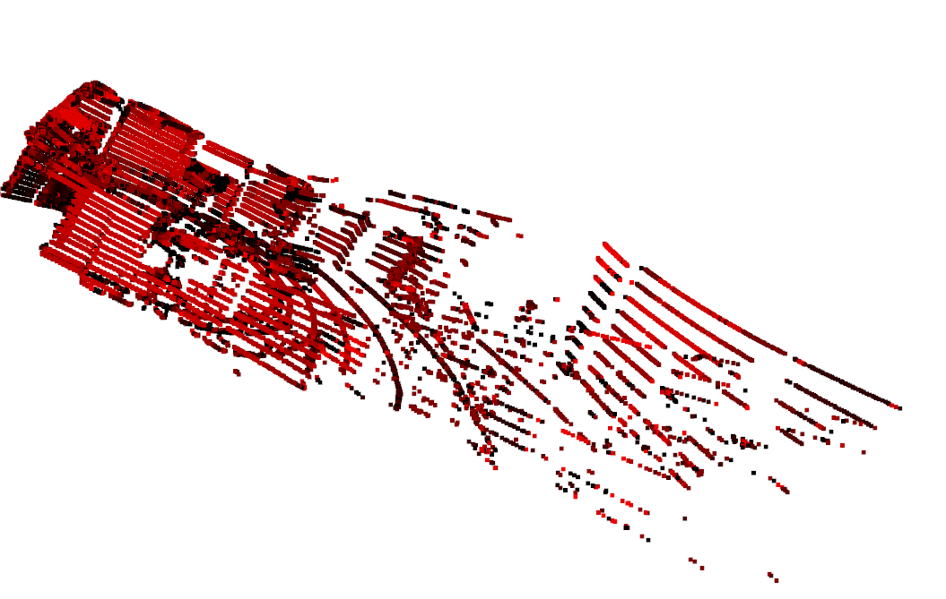
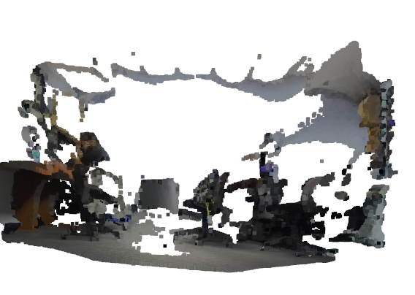
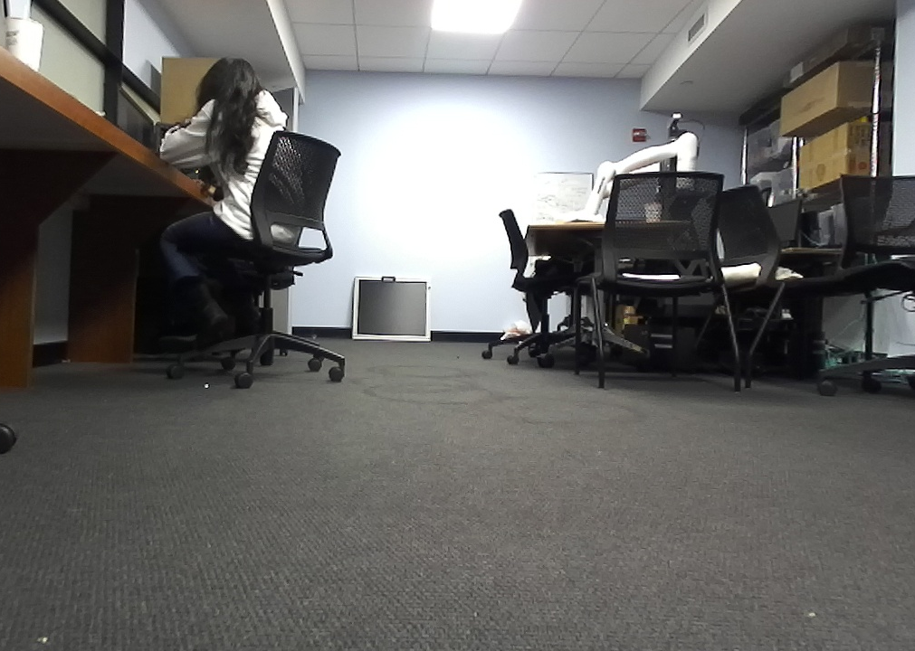
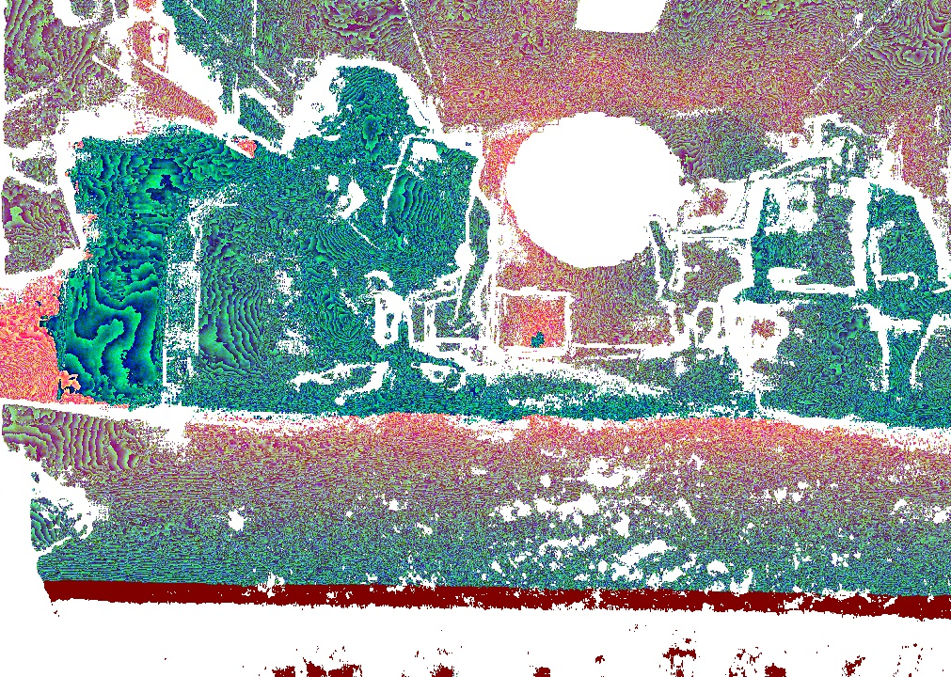
Dataset that is captured from jackal robot of 100 dataset of each category shown on right hand side.
For Training my model I would be using the Dataset from the Kiti data set : https://www.cvlibs.net/datasets/kitti/eval_object.php?obj_benchmark=3d .
Velodyne point clouds, if you want to use laser information (29GB)
right color images, if you want to use stereo information (12GB)
annotated depth maps data set (14 GB)
projected raw LiDaR scans data set (5 GB)
manually selected validation and test data sets (2 GB)
3D Point Cloud
Dataset
2d Image
3d Depth Image

Slide 7
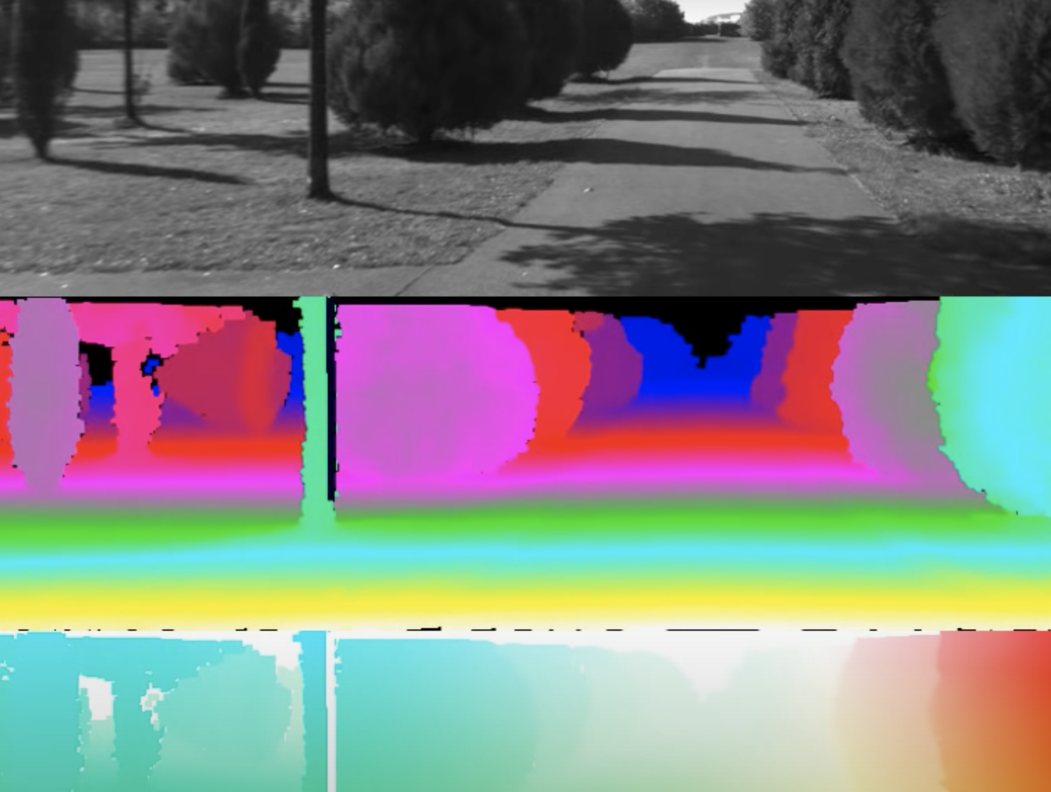
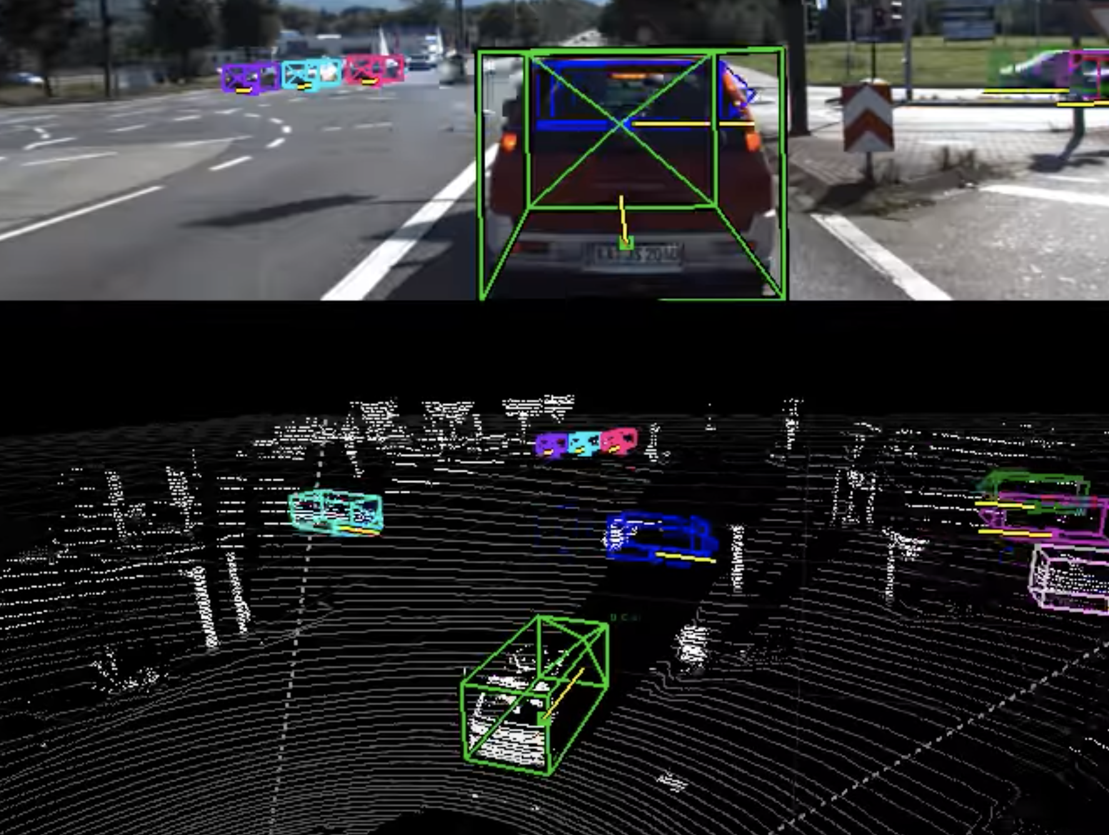
Example data that I would be getting from Kiti dataset

Slide 8
Thank You

